Slide 1
Unsupervised learning

Slide 2
Unsupervised Learning
In unsupervised learning there is no specific outcome that we want to predict.
It is a generic class of machine learning problems.
A common case of unsupervised learning is the case of clustering (or cluster analysis).
Not having a specific outcome often make it hard to define objective performance criteria

Slide 3
Supervised Learning
X₁ | X₂ | X₃ | … | X_{n-2} | X_{n-1} | X_{n}
x_{1,1} | x_{2,1} | x_{3,1} | … | x_{n-2,1} | x_{n-1,1} | x_{n,1}
x_{1,2} | x_{2,2} | x_{3,2} | … | x_{n-2,2} | x_{n-1,2} | x_{n,2}
. . . | . . . | . . . | … … … | . . . | . . . | . . .
x_{1,m-1} | x_{2,m-1} | x_{3,m-1} | … | x_{n-2,m-1} | x_{n-1,m-1} | x_{n,m-1}
x_{1,m} | x_{2,m} | x_{3,m} | … | x_{n-2,m} | x_{n-1,m} | x_{n,m}

Slide 4
Agenda
Clustering
Association rules
Semi supervised learning

Slide 5
Clustering
General objective: group objects together, into clusters, according to their similarity.
Objects in the same group should be similar. Object in different group should be different.

Slide 6
Clustering
What are the common characteristics that form the cluster is a different (and often difficult) question.
Most algorithms will output a set of clusters (that are what they are designed for). It is our responsibility to verify that this clustering is valuable for us.

Slide 7
Clustering – potential use cases
Segmentation (in marketing)
Building a product catalog
Social networks analysis
Data reduction / simplicity
Anomaly / outlier detection
Data exploration
Topic modeling

Slide 8
K-Means
K-Means is a simple approach to clustering

Slide 9
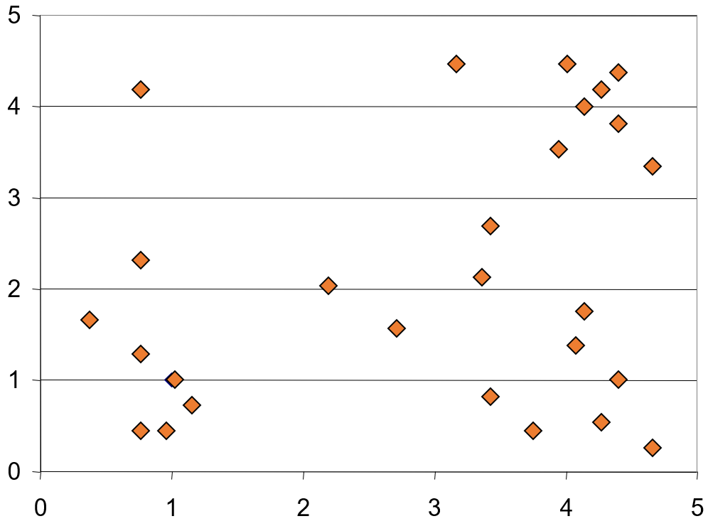
K-Means

Slide 10
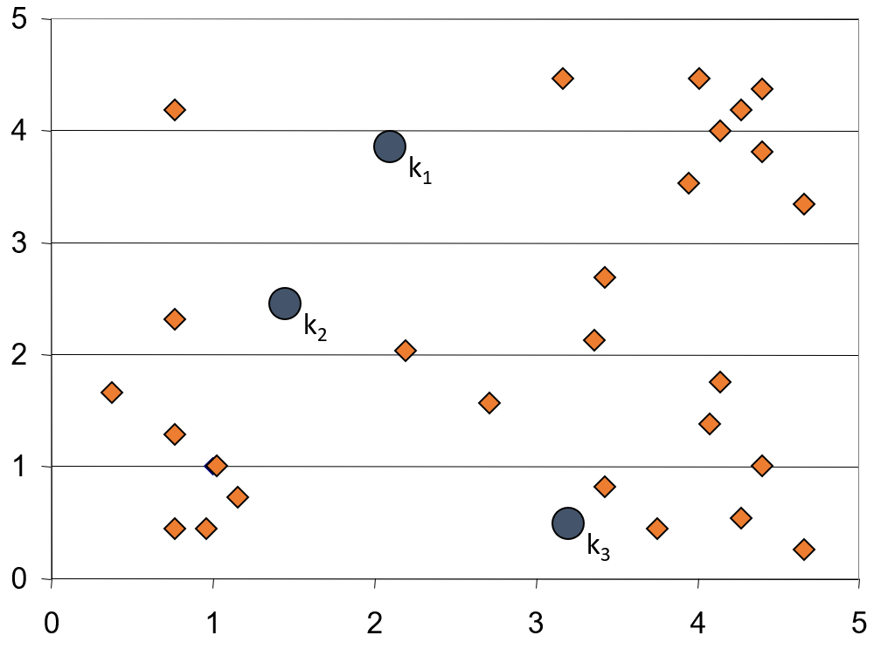
K-Means

Slide 11
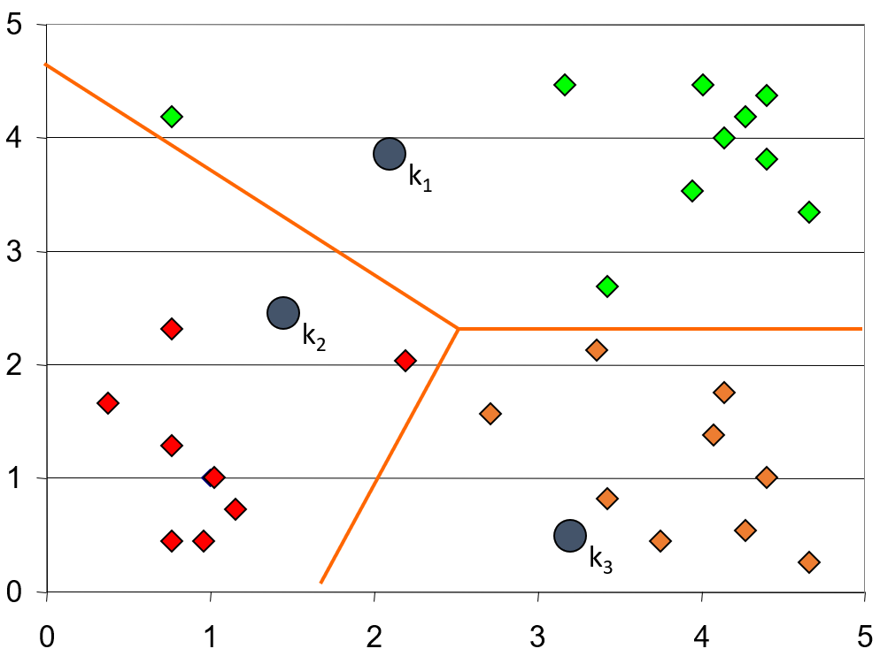
K-Means

Slide 12
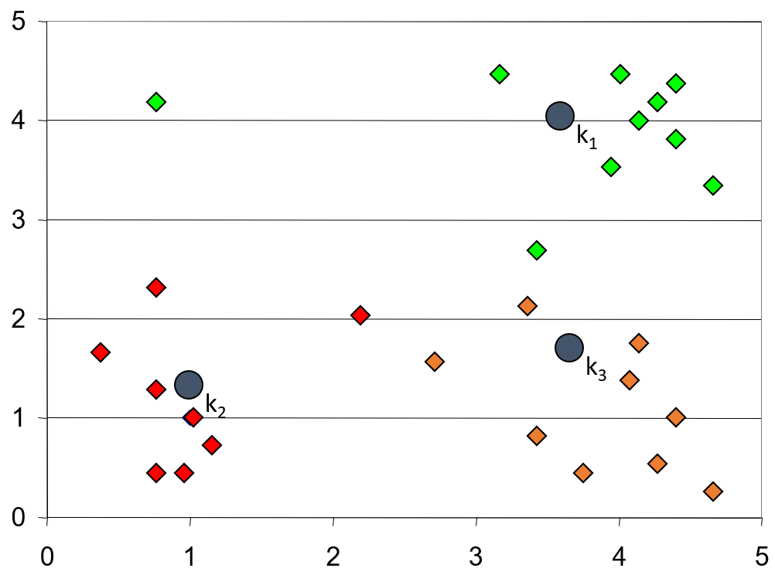
K-Means

Slide 13
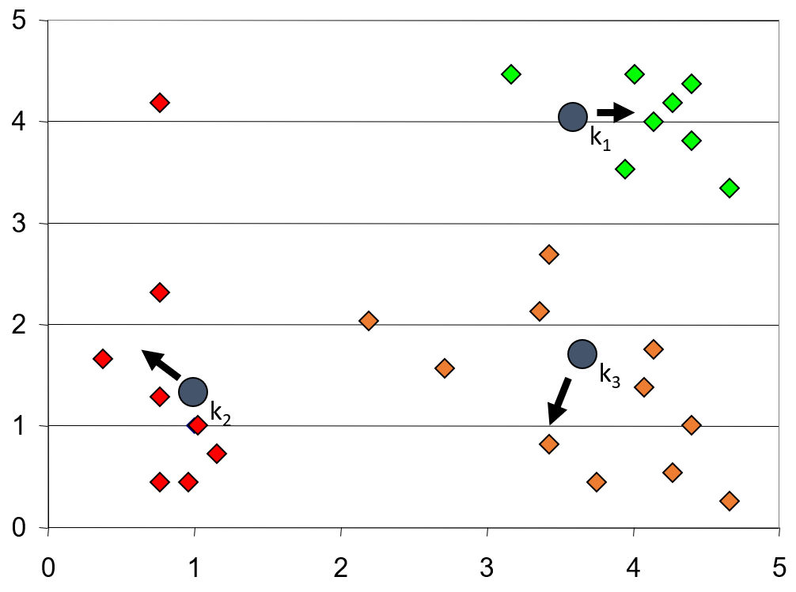
K-Means

Slide 14
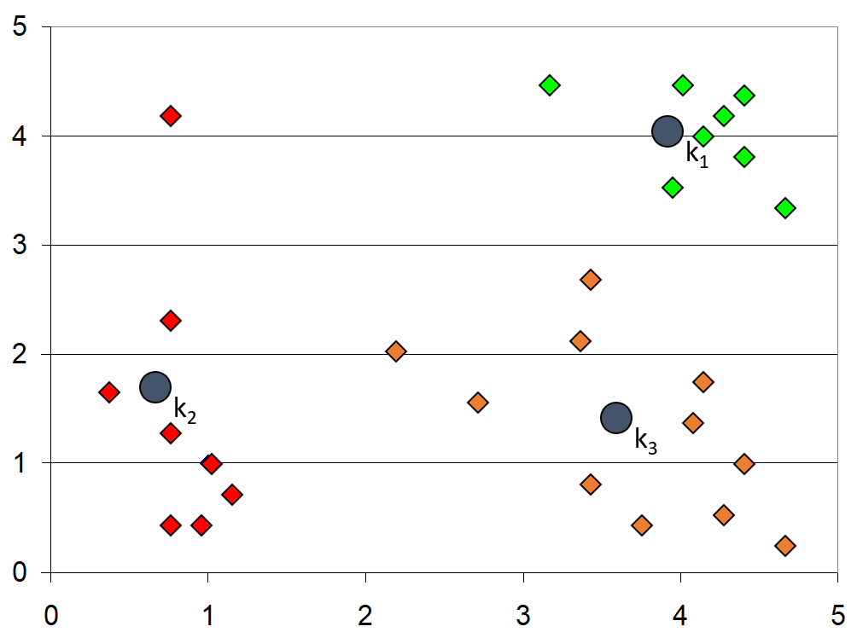
K-Means

Slide 15
K-means
K stands for the number of clusters, which is typically a user input.
K-Means is iterative by it’s nature.
It will always converge, however only a local minimum is obtained.
Works only for numerical data.
Very easy to implement.
You can search for the optimal K using “technical” measures.
You can start with “smart” K initialization.

Slide 16
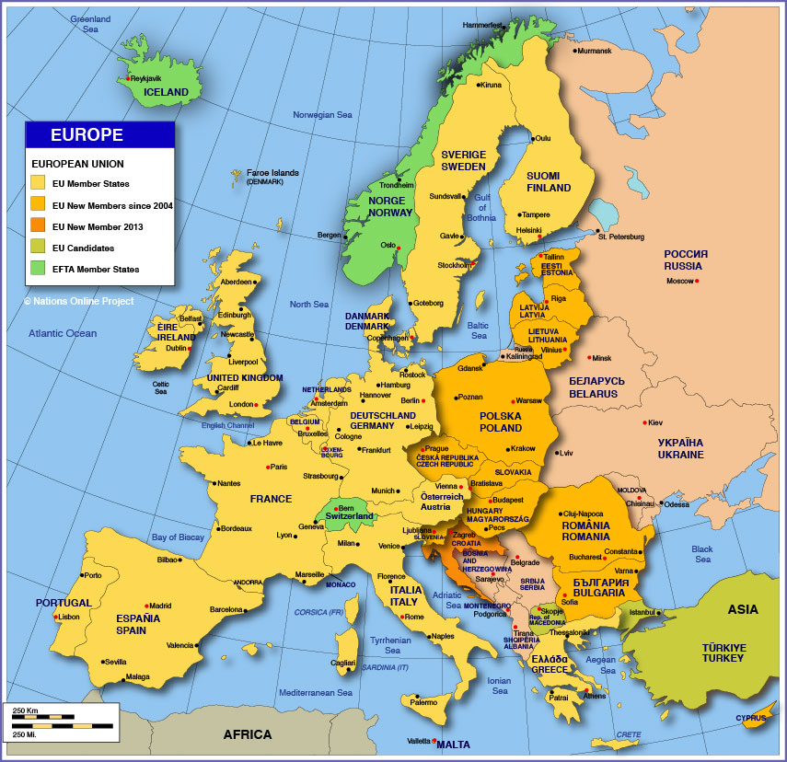
K-means
The quality of the clustering often depend on the input data.

Slide 17
Gaussian Mixture Models (GMMs)
A soft clustering technique – each data point is associated with each of the clusters, but with different probability.
Assume that the observed data come from a Gaussian mixture distribution which consist of K Gaussians with their own mean and variance.

Slide 18
Gaussian Mixture Models (GMMs)

Slide 19
Gaussian Mixture Models (GMMs)
Each Gaussian is characterized by a centroid vector and a covariance matrix.
The algorithm that learns the Gaussians and fit any data point to a Gaussian is called EM (Expectation Maximization).
GMM can be thought of an extension to k-means, which considers the distribution of the data.
The output might be useful even if the input data is not a Gaussian Mixture.

Slide 20
Hierarchical clustering
In hierarchical clustering objects are either:
Grouped together hierarchically in a bottom-up manner (agglomerative clustering), or
Divided into sub groups in a top-down manner (divisive clustering).
Hierarchical clustering is more computation intensive, but it can reveal the “true” structure of the data
Hierarchical clustering just group the objects together. It does not divide the entire space

Slide 21
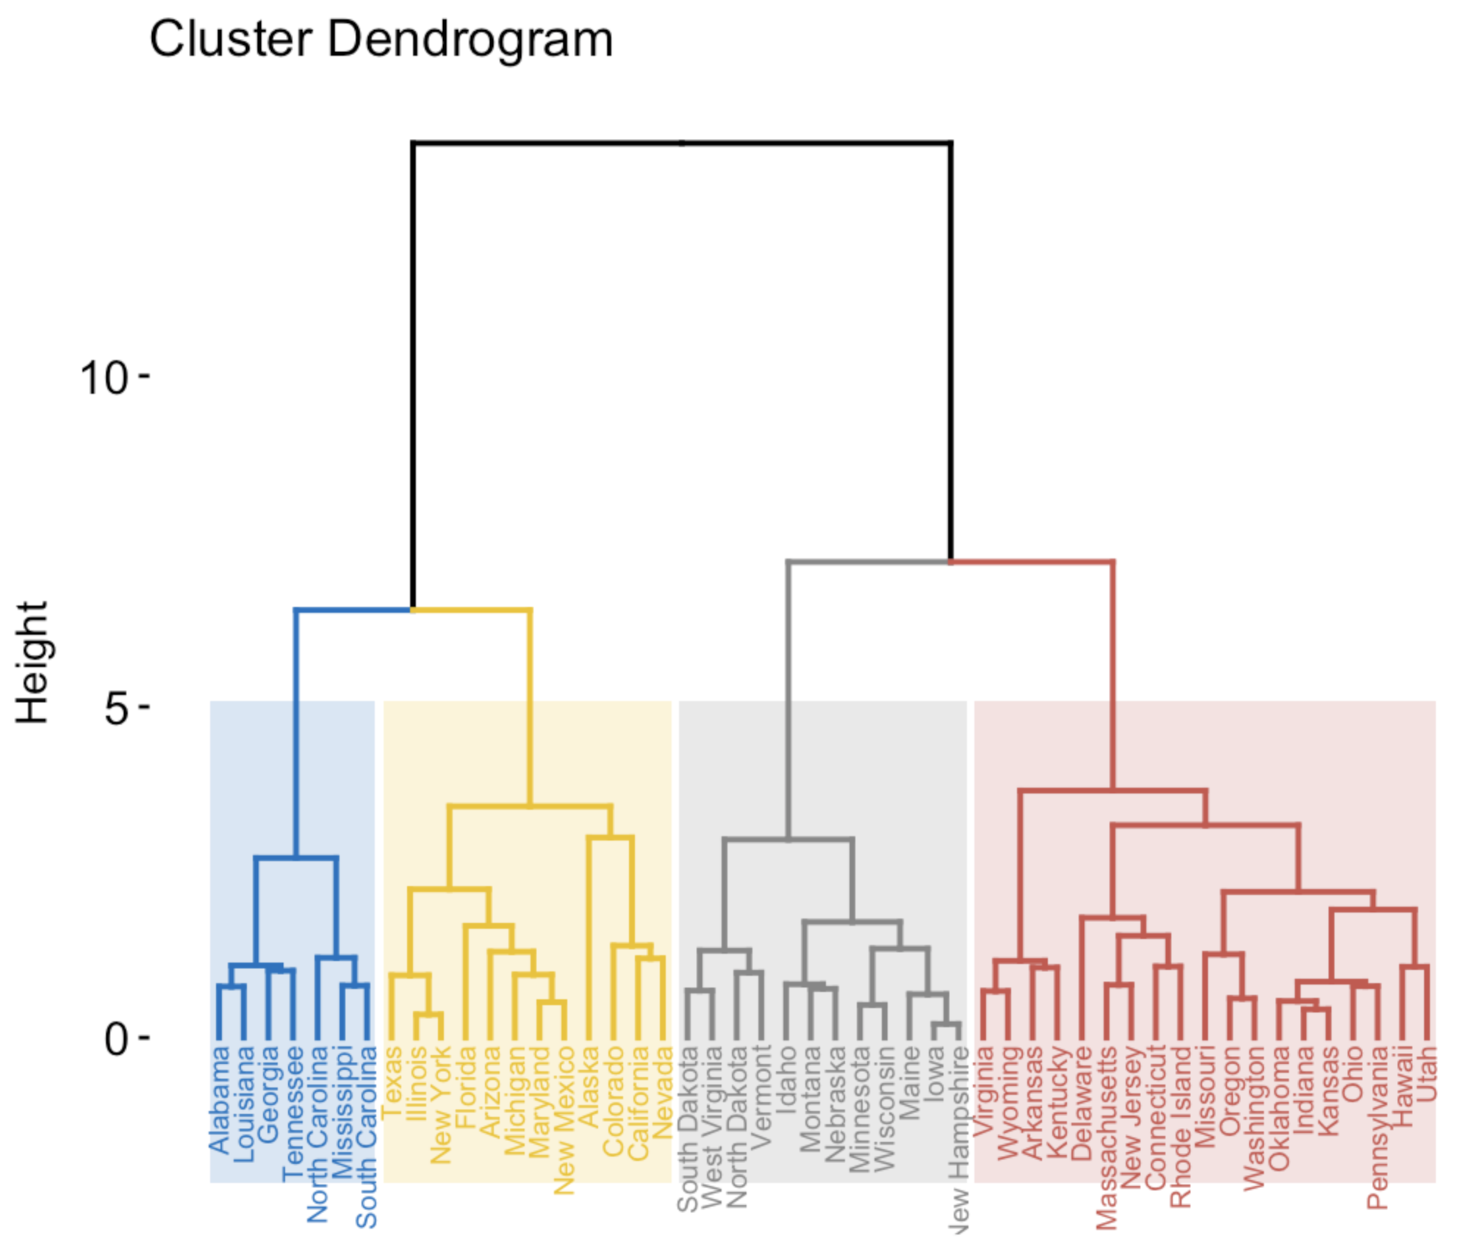
Hierarchical clustering: a dendogram

Slide 22
Hierarchical clustering
Hierarchical clustering requires:
The distance between any two objects
A method for defining the distance between two groups of objects:
The shortest distance between two objects in a group
The longest distance
An average distance

Slide 23
Density-based clustering
In density-based clustering, clusters are defined as areas of higher density than the remainder of the data set.
Objects in the sparse areas are usually considered to be noise and border points.
The most popular density based clustering method is called DBSCAN.

Slide 24
Density-based clustering

Slide 25
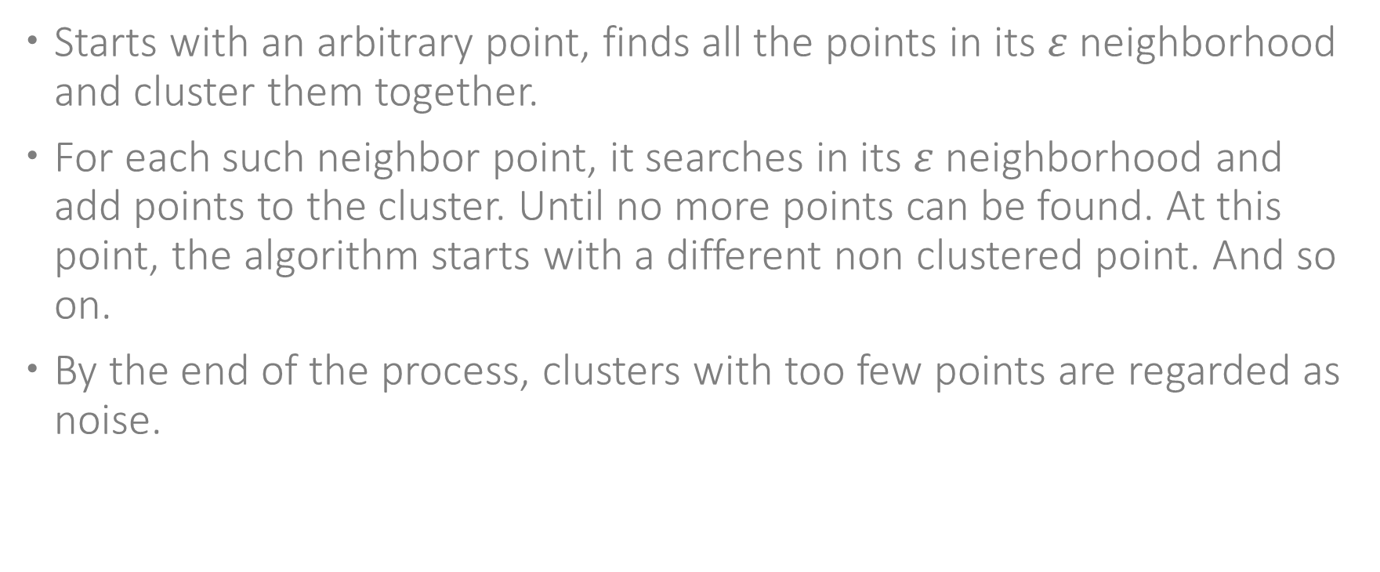
DBSCAN
Starts with an arbitrary point, finds all the points in its $ε$ neighborhood and cluster them together.
For each such neighbor point, it searches in its $ε$ neighborhood and add points to the cluster. Until no more points can be found. At this point, the algorithm starts with a different non clustered point. And so on.
By the end of the process, clusters with too few points are regarded as noise.

Slide 26
Density-based clustering and anomaly detection
Anomaly detection is the search unique / unexpected / rare cases.
The anomalies might be explicitly labeled (e.g., credit card frauds), in which case in most cases the solution approach is supervised learning.
In many cases, however, the anomalies are not labeled:
Click frauds
Healthcare applications
Network performance monitoring
Density-based clustering is useful for detecting anomalies in unsupervised scenarios.

Slide 27
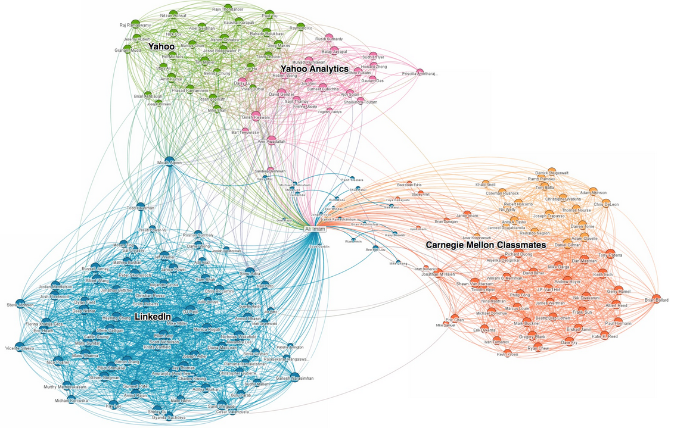
Graph clustering

Slide 28
Graph clustering
Graph clustering have two main steps:
Describe objects by a similarity graph
Search for strongly connected sub graphs
Applications include:
Social networks analysis (finding clusters of researchers that publish on similar subjects; Collecting intelligence, Finding opinion leaders)
Automatic categorization of items (e.g., mobile applications)
Gene clustering

Slide 29
Topic modeling
The task: discover abstract topics that appear in a large set of documents.
Each topic is assumed to use a different dictionary. The typical topic modeling algorithms use EM (similar to GMMs).

Slide 30
Clustering and similarity
Clustering methods are typically based on our ability to measure distances, and on the assumption that these distances represent similarity.
And similarity is in the eye of the observer…

Slide 31
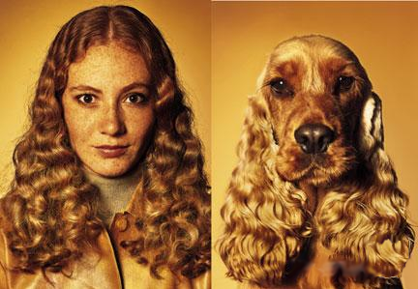
Clustering and similarity

Slide 32
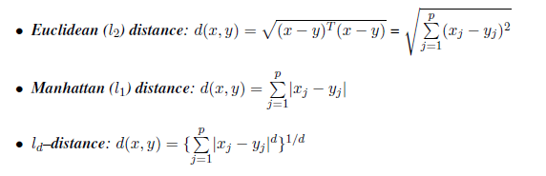
Typical distance measures

Slide 33
Typical distance measures
Cosign distance
Jaccard distance

Slide 34
Clustering performance
Measuring the quality of a clustering model is not well defined
Business criteria:
Do the different cluster indeed represent different groups?
Do they support a business use case?

Slide 35
Clustering performance
Measuring the quality of a clustering model is not well defined
Technical (internal) measures:
Between vs. within class variance
% of explained variance
Many times, we can optimize over these measures. But the question remains: do these internal measures represent good clustering

Slide 36
Association rules
Find rules that describe associations between specific values of the explaining variables.
Very useful in market basket analysis: what items do customers tend to buy together?
Design special offers and prepare product packages
Make personalized recommendations

Slide 37
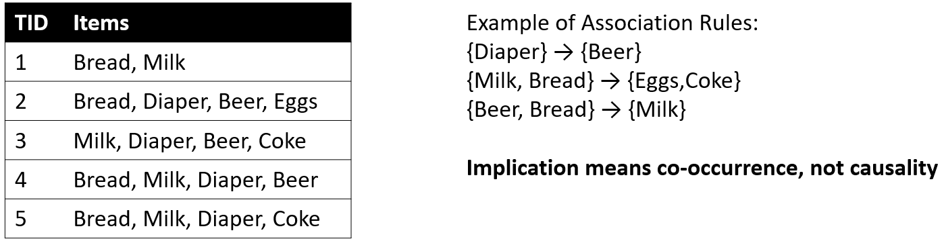
Association rules

Slide 38
Association rules
Item set
A collection of one or more items
K-item set – An item set that contains k items
Item set’s Support - Fraction of transactions that contain an item set
Frequent item set - An item set whose support is greater than or equal to a min support threshold.
Association rule - An implication expression of the form X → Y, where X and Y are item sets.
Association rule support: the support of an itemset that consists of X and Y.
Association rule confidence: the fraction of transactions that include X that also include Y
Association rule lift: the confidence of the rule, divided by the support of Y

Slide 39
Association rules
Interesting association rules should have:
High support
High confidence
High or low lift
Practically, we pre-define a threshold for each of these measures.

Slide 40
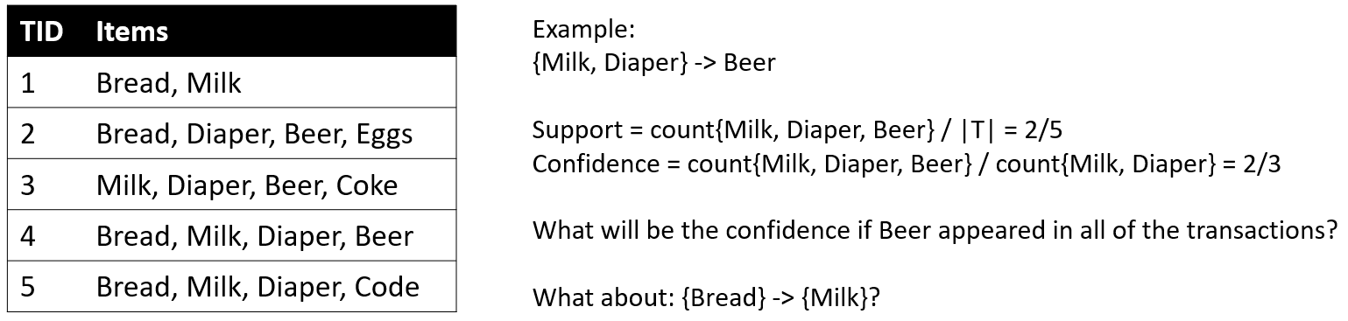
Association rules
Example:

Slide 41
Association rules
Basic flow of a rules discovery algorithm:
Find all the frequent itemsets (frequent itemsets of size 2, 3, 4, 5, …)
Extract rules from these itemsets
Given a frequent itemset {A,B,C} evaluate the following rules: A→{B,C}; B→{A,C}, C→{A,B}, {A,B}→C, {A,C}→B, {B,C}→A
Theoretically both tasks are computationally intensive. But…

Slide 42
Association rules
Any subset of a frequent itemset must also be a frequent itemset.
{A,B,C,D} cannot be a frequent itemset without all the following:
{A,B,C} is a frequent itemset (which it turn means that {A,B}, {A,C} and {B,C} are all frequent)
{A,B,D} is a frequent itemset
{B,C,D} is a frequent itemset
That means that practically we can search for frequent itemsets starting from small size and increasing, and very quickly we can finish the search.

Slide 43
Association rules

Slide 44
Association rules
For the second step of the algorithm, we can also search smartly:
c(ABC -> D) >= c(AB -> CD) >= c(A -> BCD)

Slide 45
Association rules

Slide 46
Association rules
Summary
Association rule algorithms tend to produce too many rules
Many of them are uninteresting or redundant
Interestingness measures can be used to prune/rank the derived patterns

Slide 47
Agenda
Clustering
Association rules
Semi supervised learning

Slide 48
Semi-supervised learning
Semi supervised learning is a situation in which in your training data some of the samples are not labeled (usually a significant part of the samples).
Examples:
In fraud detection, you have just few frauds labeled, and all the rest of the transactions are either frauds or legitimate.
In image detection you have many samples of images, but just few with the relevant objects that you want to detect.
In signal processing, you have many many signals, but most of them has no associated label.

Slide 49
Semi-supervised learning
Using the unlabeled samples you can better capture and shape the underlying data distribution and generalize better to new samples.
For example, you can use auto-encoders for all the images, and use the decoded features to classify the specific samples with the labeled objects.
Anomaly detection methods (e.g., DBSCAN can produce outliers that can be marked as suspects, which we can verify in post processing)

Slide 50
Unsupervised learning – specific use cases
Unsupervised learning is a broad class of tasks. Many times we tackle a new use case, which translate to a data task, with no specific label:
Extractive auto summarization: output these sentences from a long documents, which “cover” as many other sentences as possible
Embedding: find a useful way to represent high-dimensional vectors (a well-known example is word2vec).
The work of a data scientist also include the modeling of these use cases.

Slide 51
Unsupervised learning

